Slide 1


SAP S/4HANA Training
MASTER DATA GOVERNANCE (SAP MDG)
Neeraj Gupta
Session 26
SAP MDG – Performance, Editions

Slide 2
Performance improvements
26
SAP MDG – Performance
Hardware Requirements and System Performance
Reference System
Native System or Virtual Machine
Application Configuration and UIBBs
State of Building Blocks and Lazy Load
Hierarchical UI
Governance Scope
Memory Consumption
Direct Call of OVP
Custom UIBBs
Implementation Hints
SAP Notes
Custom Code

Slide 3
Performance improvement Checklist
26
SAP MDG – Performance
What is the specification of your reference system (if applicable: number of SAPS)
What type of system (development, test, productive)?
Native or virtual system?
Which MDG release is used?
Did you test your installation like proposed
What are the results in runtime for the given example?
How long does the application start take for the overview screen (OVP)?
With standard SAP configuration (Change Request and Basic Data expanded,
others are collapsed)
With custom configuration? Please name the UIBBs expanded as well.
Is the application configuration modified in your implementation?
Are custom UIBBs added?
Which implementation hints did you consider for your custom UIBB?
Did you check the implementation hints for custom code?
If you face performance issues, did you…
Update the kernel to the latest patch?
Import the latest NetWeaver/FPM support packages
Consider SAP Note 2105467

Slide 4
Editions
26
SAP MDG – Edition
Edition Based Process Flow
Edition Type – It identifies the Data Model and Entity Types that can be processed in an Edition

Slide 5
OG_ALL Edition Type
26
SAP MDG – Process Modelling

Slide 6
Entity type in the OG_ALL Edition Type
26
SAP MDG – Process Modelling

Slide 7
Edition creation
26
SAP MDG – Edition

Slide 8
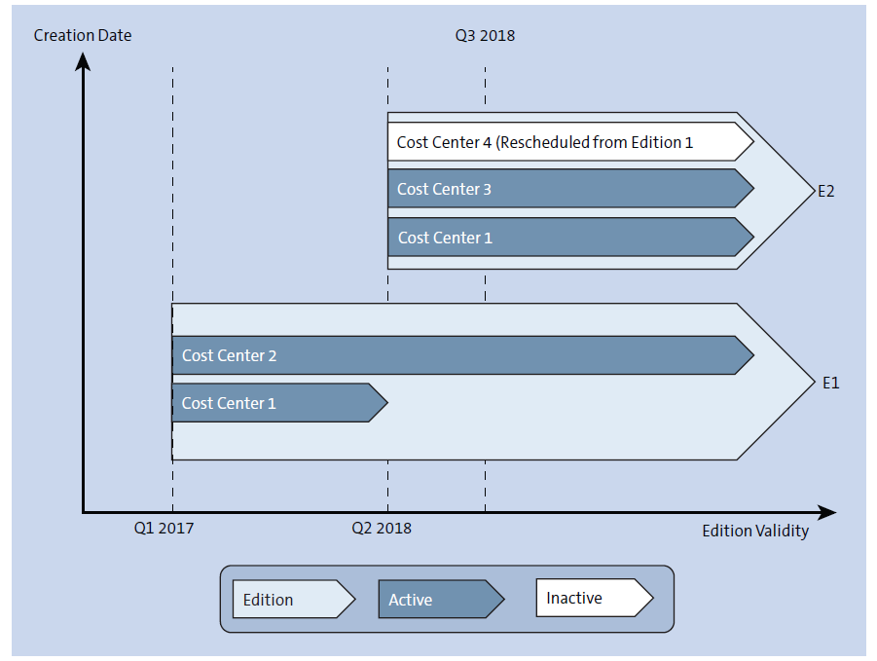
Flexibility of Edition
26
SAP MDG – Edition

Slide 9
Edition Release
26
SAP MDG – Edition

Slide 10
Edition Analysis
26
SAP MDG – Edition

Slide 11
Edition Comparison
26
SAP MDG – Edition

Slide 12

End of Session 26

Slide 13

Questions

Slide 14

Neeraj Gupta

Slide 15


We’re committed to empower you to be
Most Desirable Resource
through powerful training solutions.
We build the workforce of the future.
250+
Corporate Clients
30,000+
Learners Trained
25000+
Learners Placed
FREE WEBINARS
Sign up for free webinars with industry experts every fortnight!
Enroll Now!
Contact us today!
https://anubhavtrainings.com/

Slide 16




More from AnubhavTrainings.com

